Slide 1
SECURE DATA IN IMAGE USING STEGANOGRAPHY
CAPSTONE PROJECT
Presented By
Student Name : Kuruva Bharath
College Name & Department :
JB INSTITUTE OF ENGINEERING AND TECHNOLOGY & ECE

Slide 2
OUTLINE
Problem Statement
Technology used
Wow factor
End users
Result
Conclusion
Git-hub Link
Future scope

Slide 3
Problem Statement
With the increasing need for data security, traditional encryption methods are often prone to attacks. Steganography provides a more covert approach by embedding data within images, making it difficult for unauthorized users to detect and extract hidden information. This project focuses on implementing image-based steganography to securely hide data within images while ensuring minimal visual distortion.

Slide 4
Technology used
Programming Language: Python
Libraries:
PIL (Pillow): Image processing
argparse: Command-line interface
Concepts Used:
Binary encoding & decoding
Least Significant Bit (LSB) manipulation
Pixel data embedding

Slide 5
Wow factors
High Security: The embedded data remains undetectable to the naked eye.
Low Data Loss: The original and modified images appear almost identical.
Simple yet Effective: Uses LSB technique to efficiently hide and extract data.
Real-World Application: Used for secure communication and digital watermarking.

Slide 6
End users
Cybersecurity Experts: To enhance covert data transmission.
Journalists & Whistleblowers: Securely share sensitive information.
Government & Defense: For confidential communication.
Digital Content Creators: Protect intellectual property via watermarking.

Slide 7
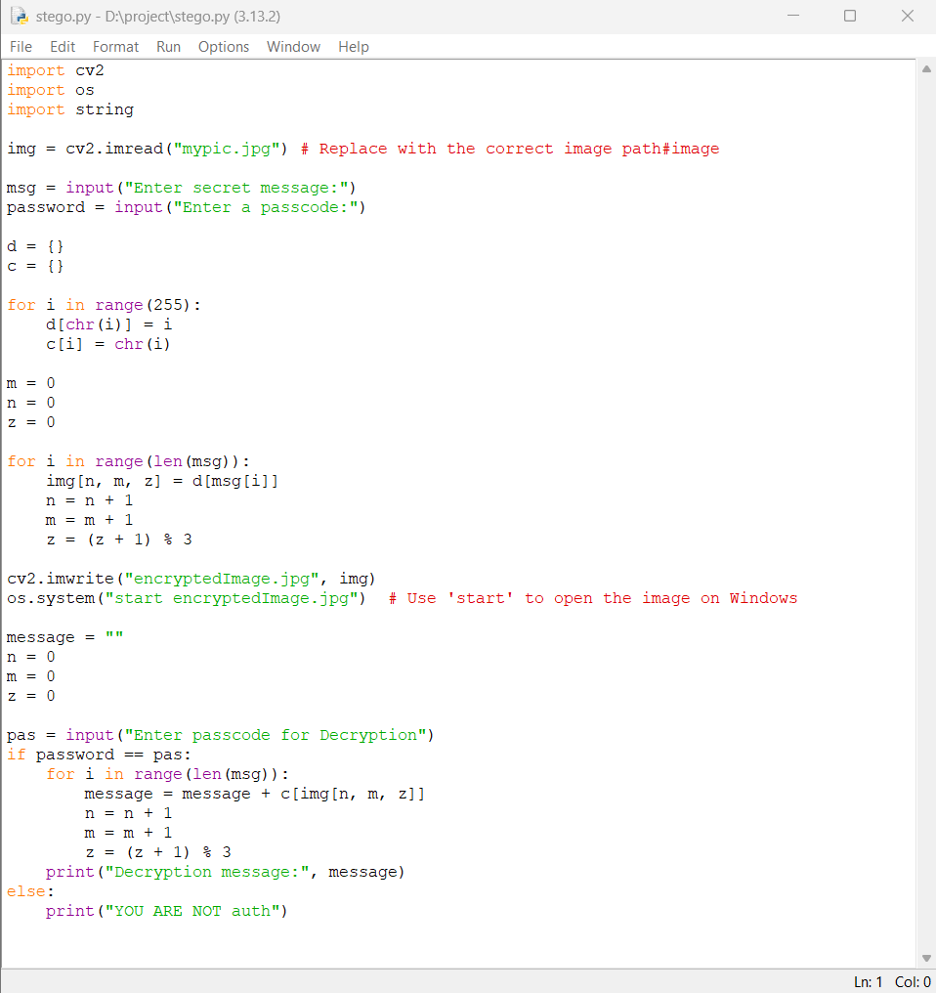
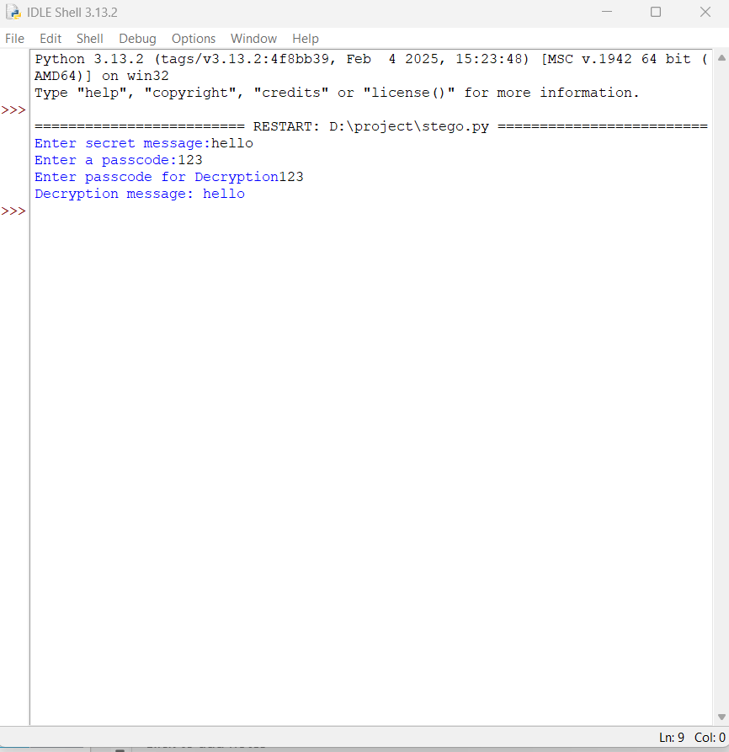
Results
CODE
GUI

Slide 8


Mypic.jpg(original image)
encryptedImage.jpg(hidden stored data)

Slide 9
Conclusion
Steganography is a powerful technique for secure data transmission. By embedding information into images, this project ensures an additional layer of security beyond traditional encryption. The implemented Python tool is efficient, user-friendly, and applicable to various fields requiring discreet communication.

Slide 10
GitHub Link
Make sure that there should be readme file
GITHUB link:- https://github.com/kuruvabharath/image-d-steganography.git

Slide 11
Future scope
Higher Capacity Steganography: Implementing techniques to store larger data.
AI-Powered Detection: Developing AI models to detect steganographic images.
Multi-layered Encryption: Combining steganography with cryptographic encryption.
Video & Audio Steganography: Expanding beyond images for enhanced security.

Slide 12
THANK YOU

